Slide 1
FEE 009 bias failure DPNC454_02A PCB

Slide 2
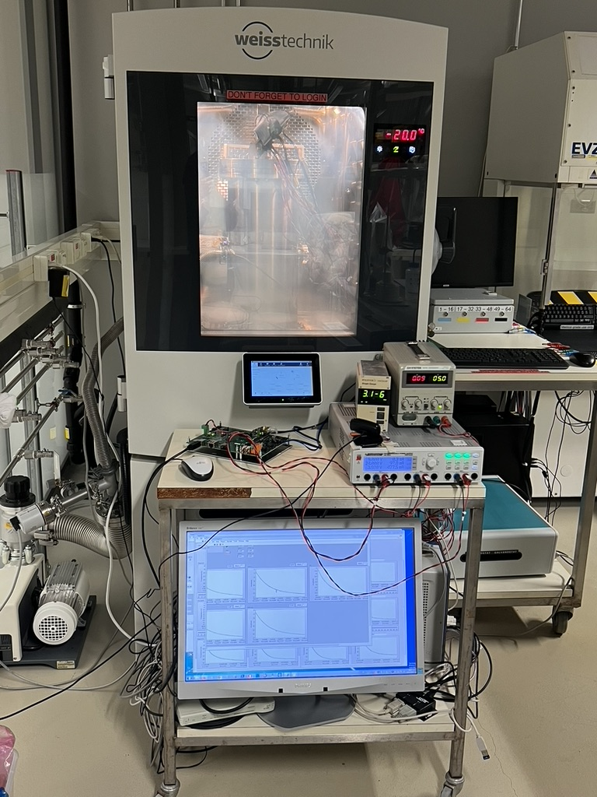
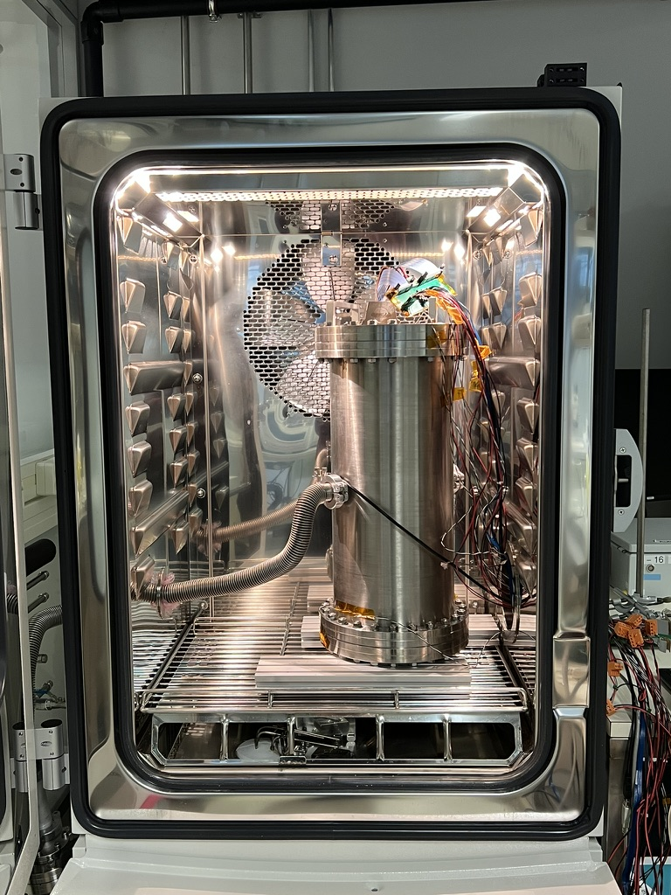
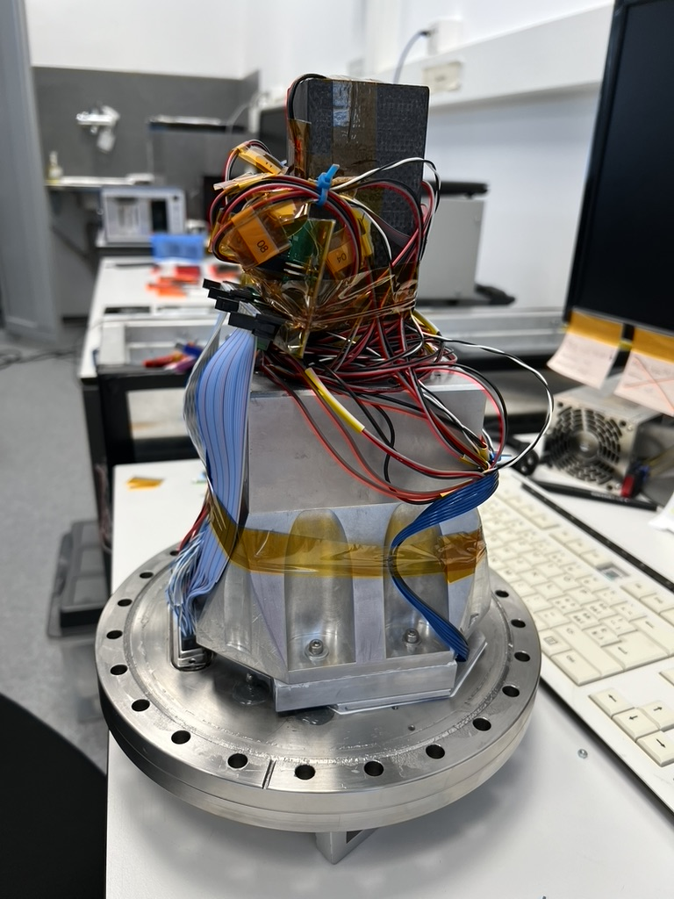
FEE 009 test at Biotech
Vacuum and chamber temperature cycling while varying heater resistors voltage mounted on the PCB (PWM control)

Slide 3
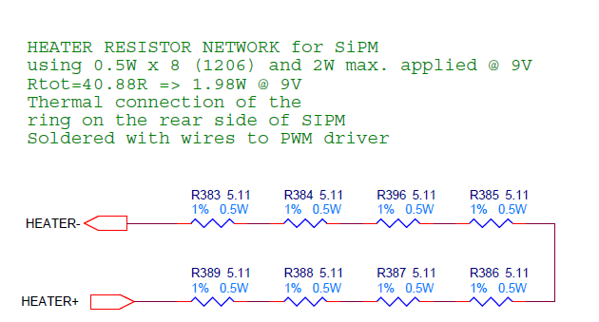
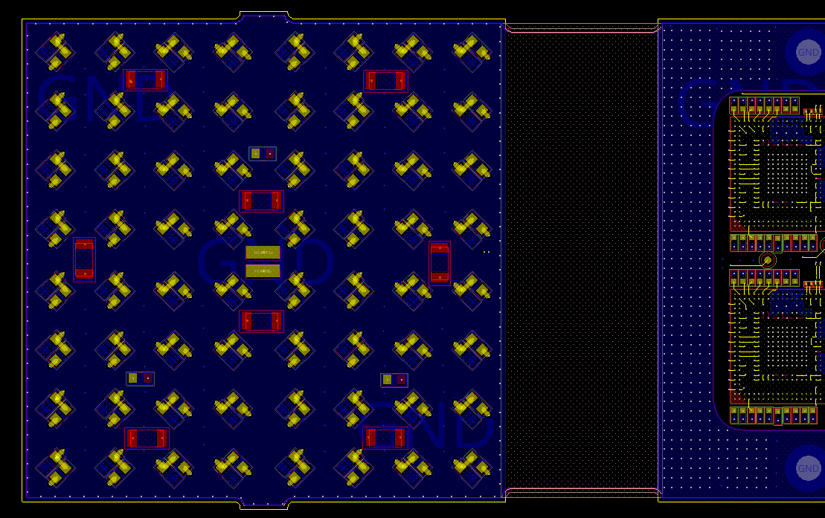
Heater test (19.12 – 20.12)
Less than 40°C measured in total with NTC on PCB
Abnormal bump
Heater resistors in red
NB: view from TOP
PWM voltage steps on heater resistors voltage mounted on the PCB (PWM control value 0, 19, 39, … 99%)
100% power = 2W max balanced over 8 x 5R11 1206 resistors on Bottom of SiPM arrays (R383-R389, R396)

Slide 4
Heater test (19.12 – 20.12)
Peltier = Heater PS
Abnormal bump in FEE power
Normal power due to heater

Slide 5
Heater test (19.12 -20.12)
57.5 V
27.5 V
The bias voltage has a current limiter: too much current => voltage drop

Slide 6
What happened ?
During the heating phase with a duty cycle of 59%:
Temperature of the SiPM sensors progressively increased by 2.5 C.
Power consumption of the 3V9 line increased by 0.3 W.
Bias voltage dropped from 53.5 V to 23.5 V.
Bias current increased to > 1 mA (max. reading of the HK).
→ There must be a short circuit on the HV line, located on the SiPM PCB.

Slide 7
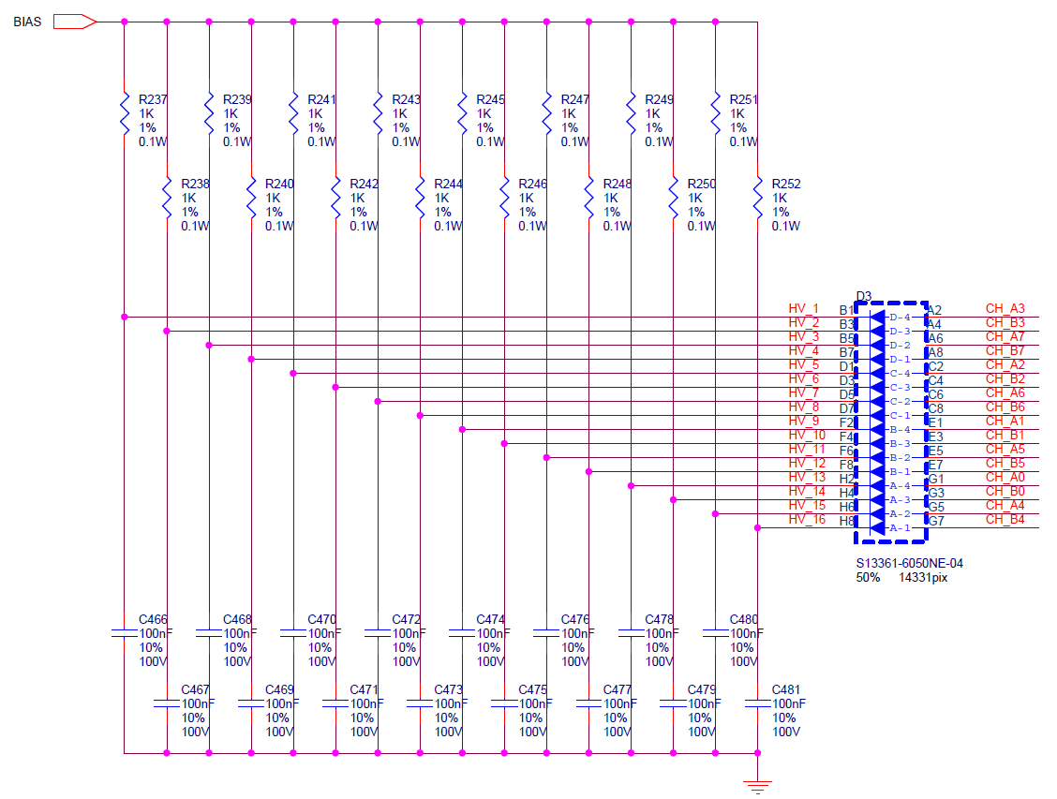
Bias distribution circuit
Repeated 4 x this 16-channels SiPM cell = 64 channels on PCB
64 x 1K/100nF cells
on PCB bottom
16-ch SiPM
Typical HV current in each HV_x cathode is very low (<100µA)
A short to GND on HVx means I_{BIAS}=V_{BIAS}/1K ~= 5.7mA
NB: view from TOP

Slide 8
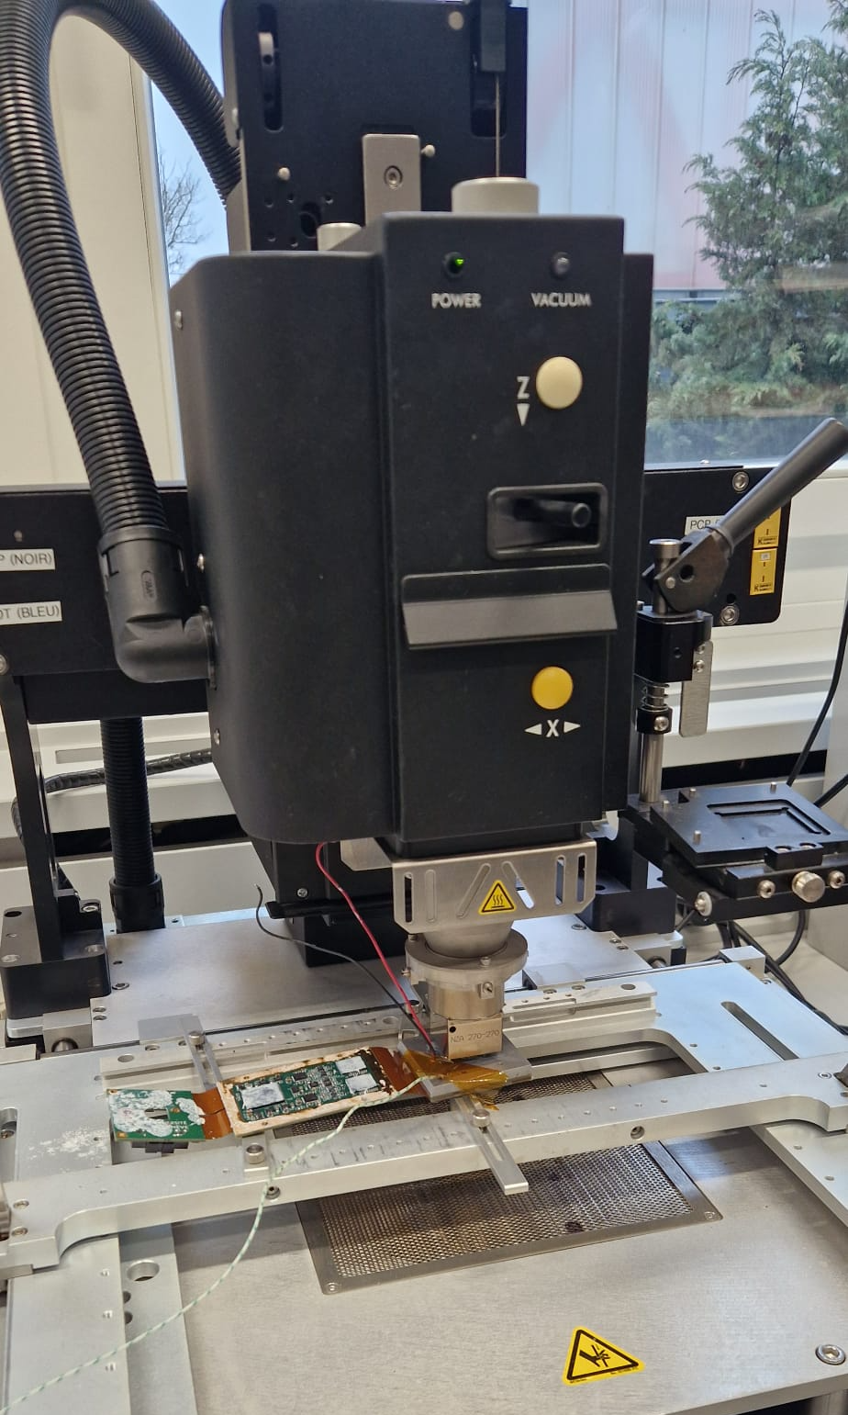
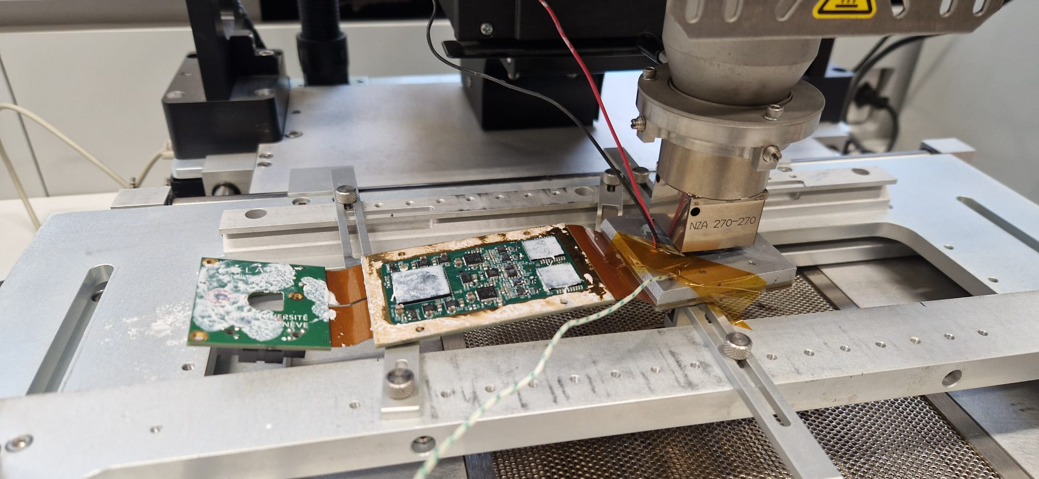
FEE dismounting

Slide 9
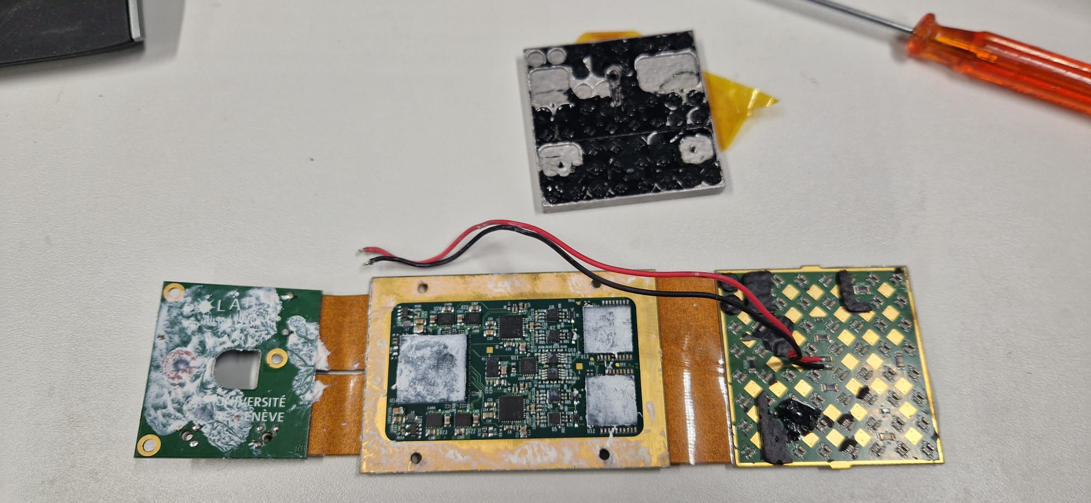
FEE dismouting

Slide 10
IR camera: 1K R215 heats when HV is on
Hot point
HV off
HV on (3550)

Slide 11
1st supposition : capa damaged
R (C444) = 200 Ohm (HV11-GND) : KO
R (R215) = 1 kOhm (BIAS-HV11) : OK
R (C447) = 2.2 kOhm (HV14-GND) : OK
→ Only one damaged component.
Capacitor C444 damaged ?
If yes thus shorts the HV BIAS to ground through 1K + 200R = 1.2 kOhm (i.e. ~5 mA)
HV source cannot sustain such a connection to ground.
HV voltage goes down to some 25 V.
All the 64 SiPMs are biased below 57V V_{bd}. => all module channels are dead with this failure
NB: view from BOT

Slide 12
Capacitor type
The FEE 009 comes from a batch of 5 boards assembled at HybridSA. Most of the passive components have been procured by HSA, in particular the 100 nF capacitors of the bias filters.
The capacitors are of the type CC0603KRX7R0BB104 (0.1 µF ±10% 100V X7R 0603) from YAGEO.
The CC type corresponds to a “normal” grade, even if the X7R temperature range is extended, from -55°C to +125°C.
Still, it is not of the automotive type (would be AC0603KRX7R0BB104).
The same indeed applied to all the components procured by HSA for this production.

Slide 13
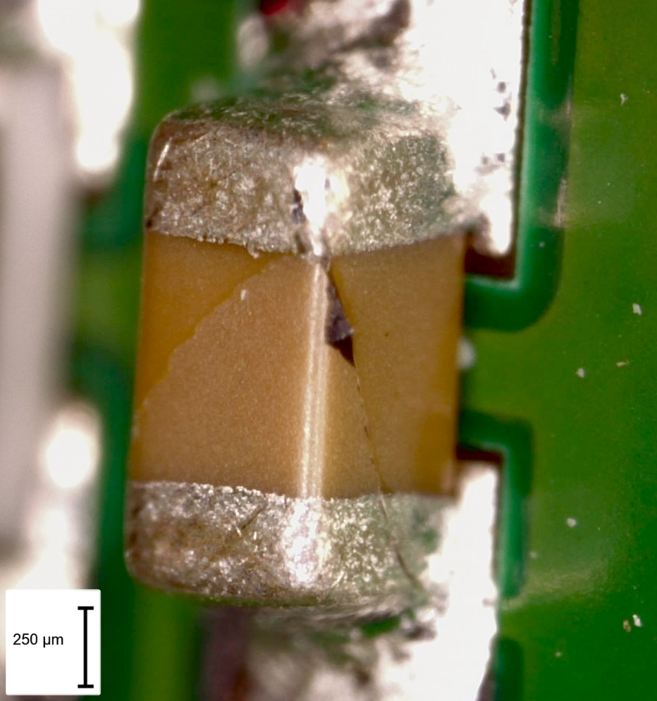
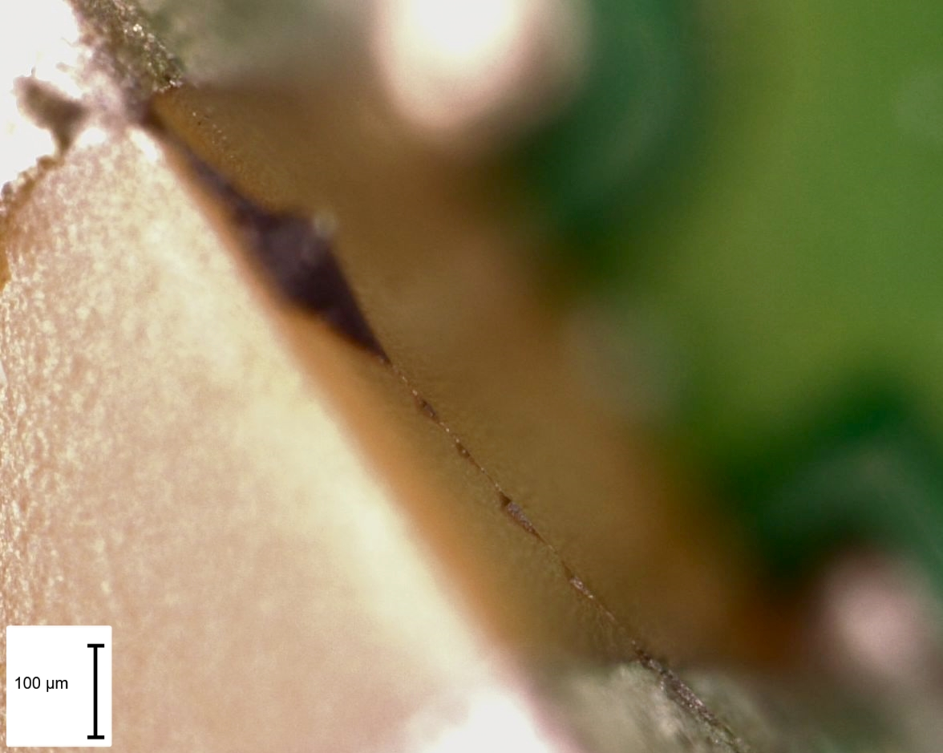
Visual inspection
The capacitor seems cracked, as show the pictures below. We can also note some resine deposits. To be understood if this ok.

Slide 14
Further steps
C444 has been replaced.
Remark: the removed cracked capa did not break during removal.
The resistive connection to ground is still present.
Various tests have been done, in particular I-V mesurements on a good SiPM channel and on the bad one, by removing the 1K resistor and soldering wires to the Cathode and Anode SiPM lines.
Good channel shows normal SiPM behaviour.
Bad channel shows a too high current when operated in reverse bias.
A 200 Ohm resistor has been soldered in parallel between the HV line and GND to simulate the problem of the bad channel: the I-V curves are similar.
=> The SiPM seems good and the PCB seems in failure

Slide 15
IV SiPM array measurements

Slide 16
IV SiPM array measurements
=> Same curve on forward and reverse biasing for bad channel and good channel with 200R to GND

Slide 17
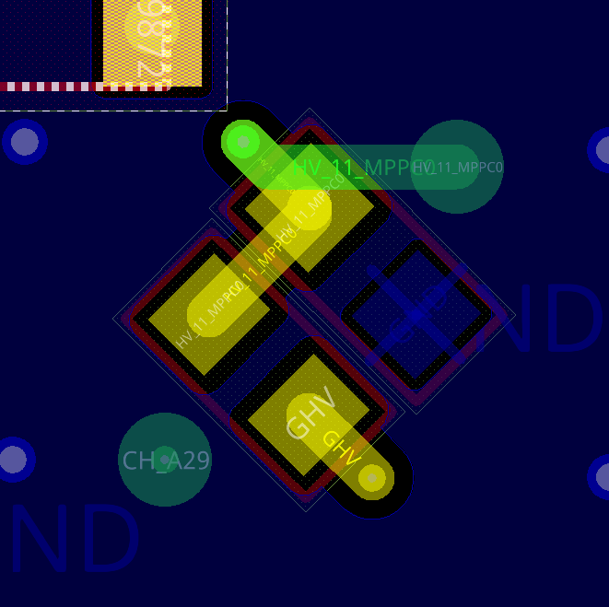
SiPM array removal
As it is not possible to clearly identify the origin of the problem, we have decided to remove the SiPM array, the capacitor and 1K resistor (only PCB traces remain)
The array still has to be measured.
But the resistive connection between the HV11 line and GND is still present on the PCB and now on a very limited area : 1 small trace on BOT (yellow) + 1 through via to TOP + 1 small trace on TOP (green).
A new IR measurement has been done.
And X-ray examination has been done.
V
NB: view from BOT
IR with curent injection from Voltage power supply

Slide 18
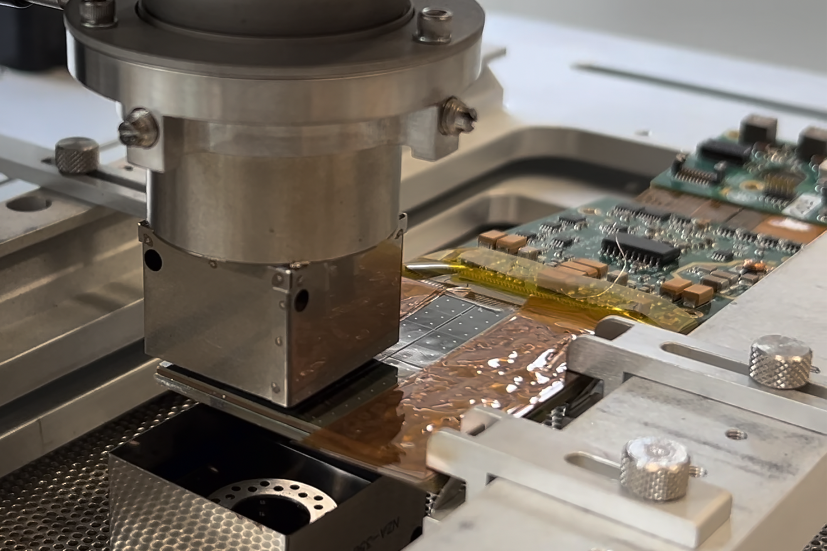
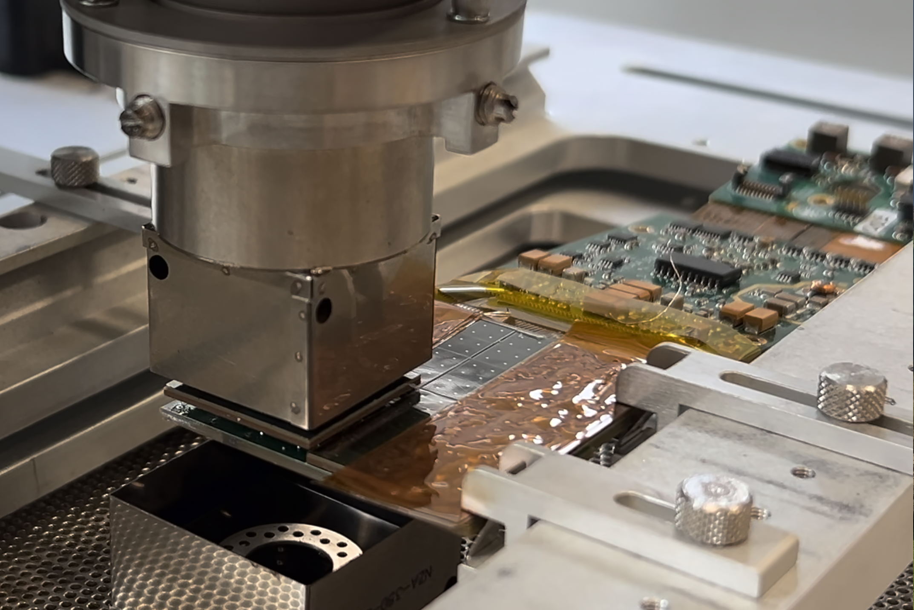
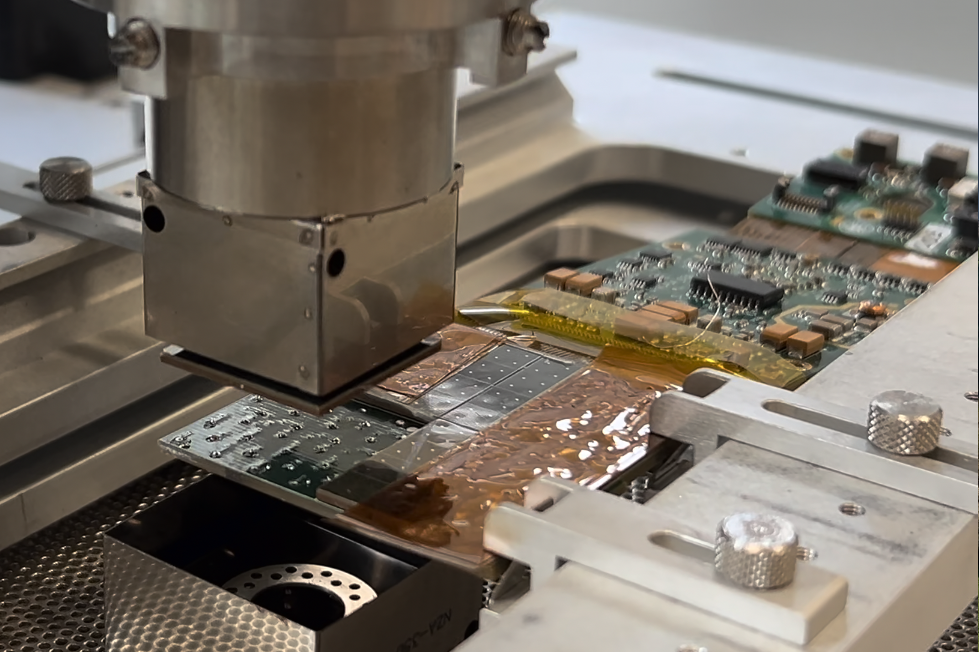
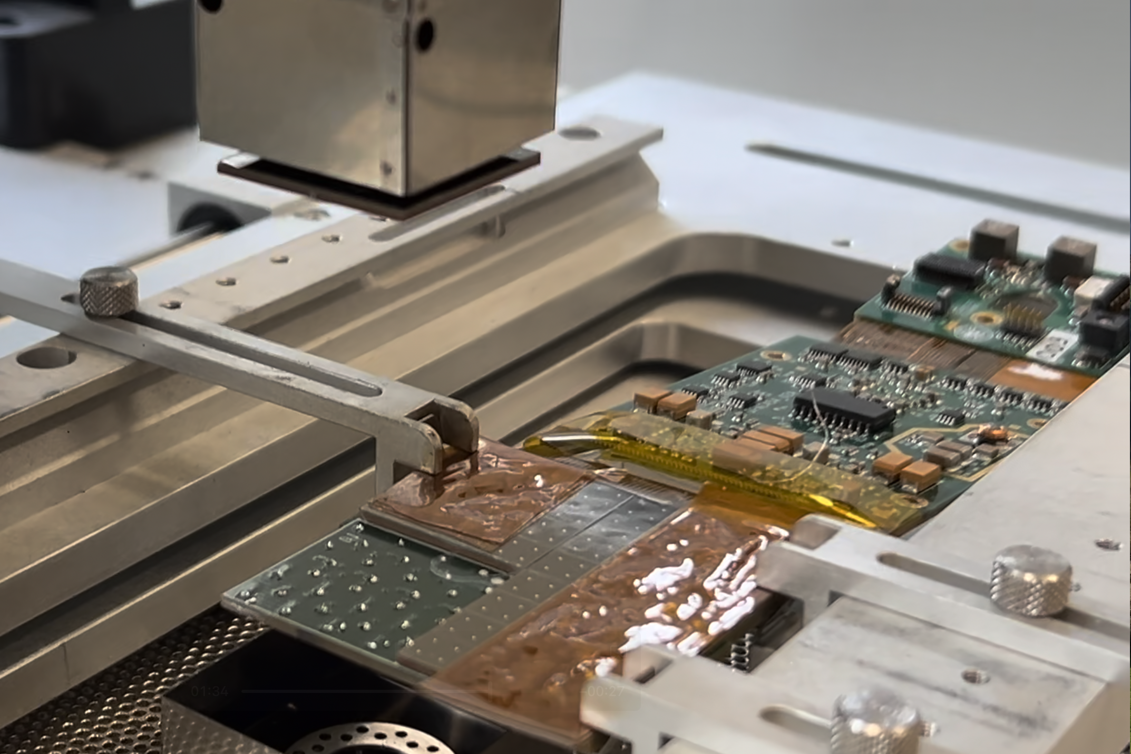
SiPM removal

Slide 19
Array I-V curves
Broken pad/
damaged SiPM
during dismounting
Same curve on bad channel (red rectangle) than others
=> SiPM is not in cause => PCB failure

Slide 20
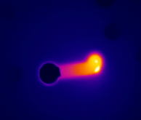
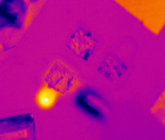
IR camera measurement
GND Failure ?
Top side
Bottom side
Injection wire
Injecting current between BOT trace to GND:
We see current in the via from BOT to TOP and seems the TOP trace corner is shorted to GND
We noted that during that test, the resistance of the connection to ground decreased to some 24 Ohms.

Slide 21
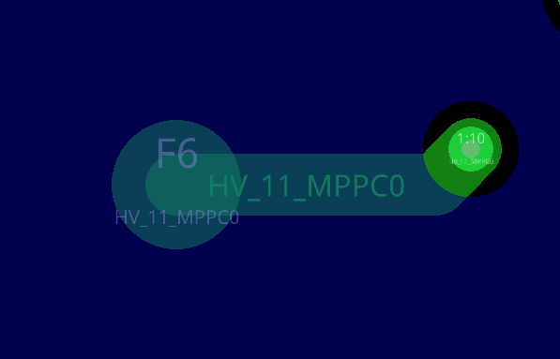
IR camera measurement
Top layer (green) and Layer 2 (GND, blue)
Top side

Slide 22
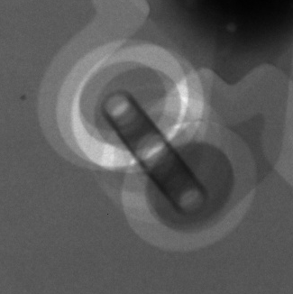
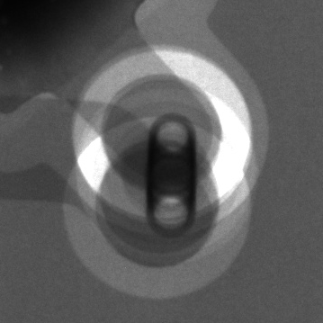
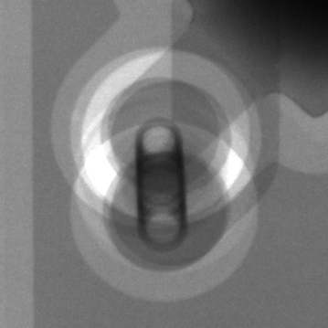
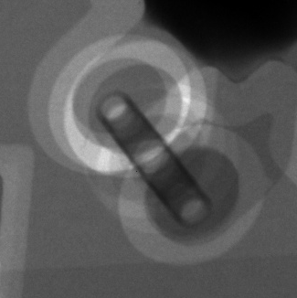
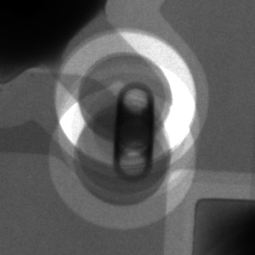
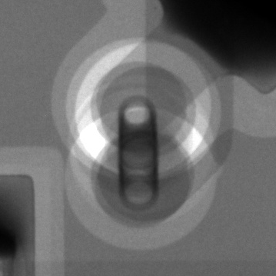
X-ray pictures (board tilted)
X-ray
Via
Board
Image
Via ‘tunnel’ due to tilt
Reference location, with no problem.
TOP
trace
Via with the problem, note the material (copper ?) depletion close to the “elbow” of the HV line (red arrow).
=> Could it be a CAF issue and this depletion some copper missing due to CAF copper migration in the FR4 from L2 (GND) to TOP (V=57V)?

